Slide 1

BSides ICS
Building Multi-Agent AI
ICS Cybersecurity Assistants & Tools
CLINT BODUNGEN
Director of Cyber Innovation – MorganFranklin Cyber
Founder – ThreatGEN

Slide 2

ABOUT ME_
Bsides ICS
_02

Slide 3
ABOUT ME_
Just kidding. Nobody really cares.
You can look me up on LinkedIn.
Moving on…
Bsides ICS
_02

Slide 4
Getting Started: Resources & References_
If you build production apps, follow Dave Ebelaar.
https://www.youtube.com/@daveebbelaar
Reference blog by Anthropic:
https://www.anthropic.com/research/building-effective-agents
GitHub repositories from this Dave:
https://github.com/daveebbelaar/ai-cookbook/tree/main/patterns/workflows
https://github.com/daveebbelaar/pydantic-ai-tutorial
01
Bsides ICS
_03

Slide 5
Getting Started: Resources & References_
GitHub Repository for all code for This Project:
https://github.com/R1ngZer0/BSidesICS-Agentic-AI-for-OT
Full YouTube Videos of The Code Being Automatically Written:
Timelapse with narrative explanation: https://youtu.be/Mf3X6_CeLb8
Regular speed, no narration: https://youtu.be/liFzLzrGEe8
01
Bsides ICS
_04

Slide 6
What is an Agent: Workflows vs. Agents_
Why agents? at are agents anyway?
What does multi-agent (“agentic”) even mean?
Workflows:
Procedural flow of processes
Simple flow control/gates
Functions/methods that call LLMs
Agents:
Automated (contextual) decision making and flow control in the process
Agent frameworks are great, but…
01
Bsides ICS
_05
Notes:
Agent frameworks like Autogen, CrewAI, etc. aren’t suited for production.

Slide 7
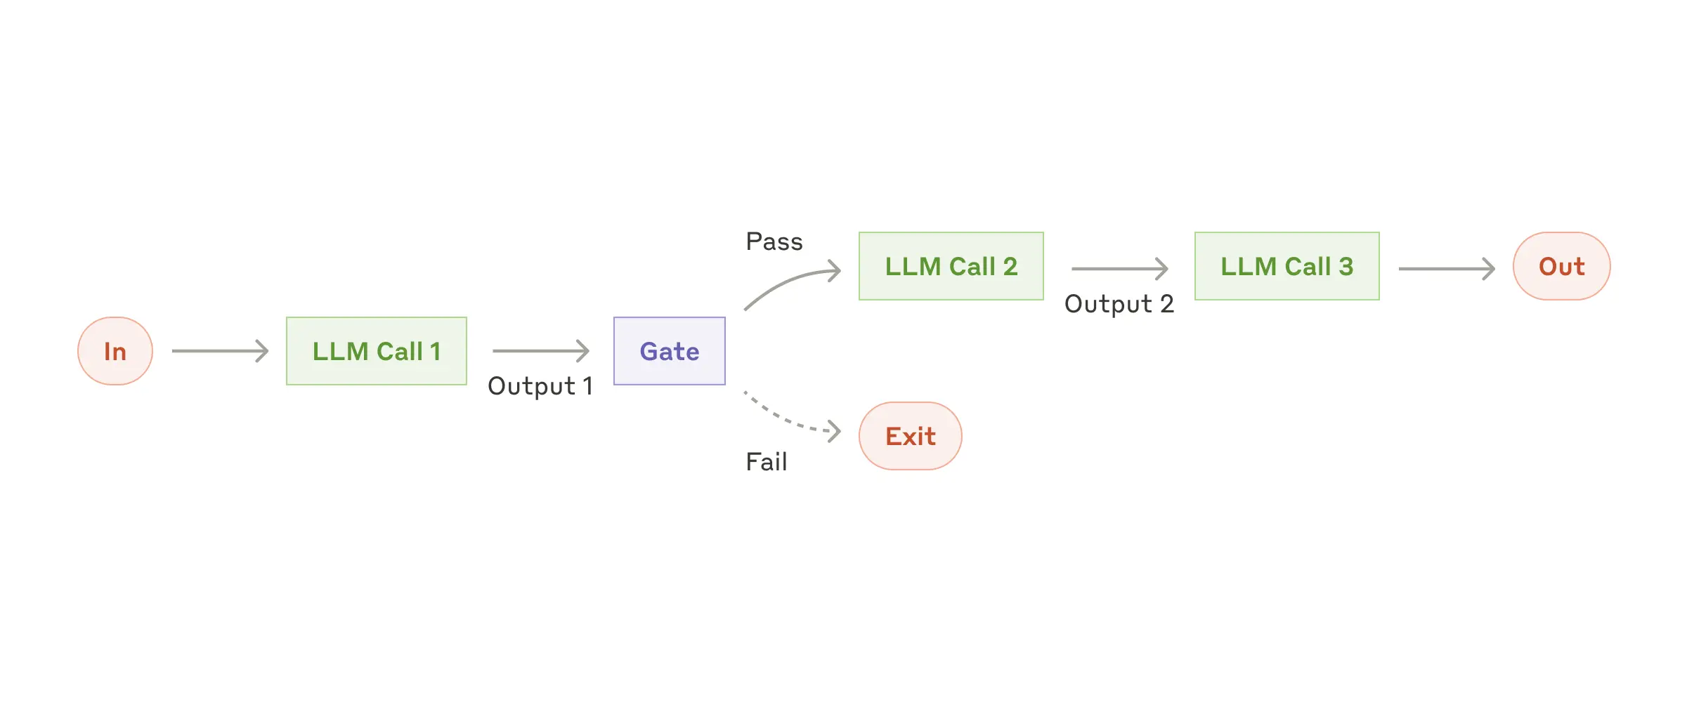
Workflow: Prompt Chaining_
01
Bsides ICS
_06

Slide 8
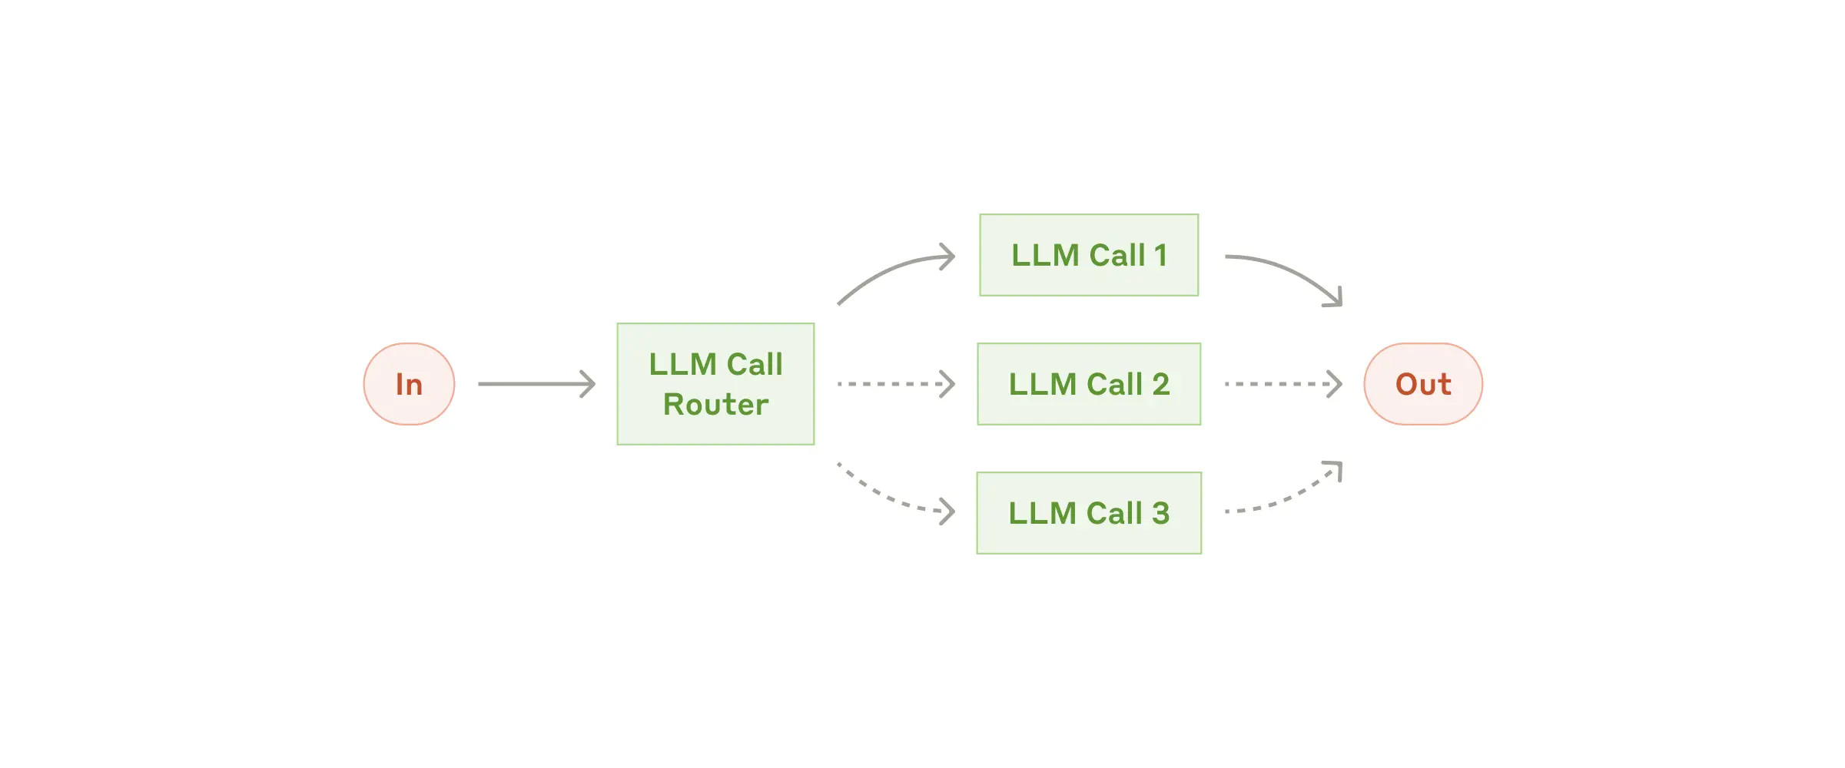
LLM Routing: Orchestrator Agents_
01
Bsides ICS
_07

Slide 9
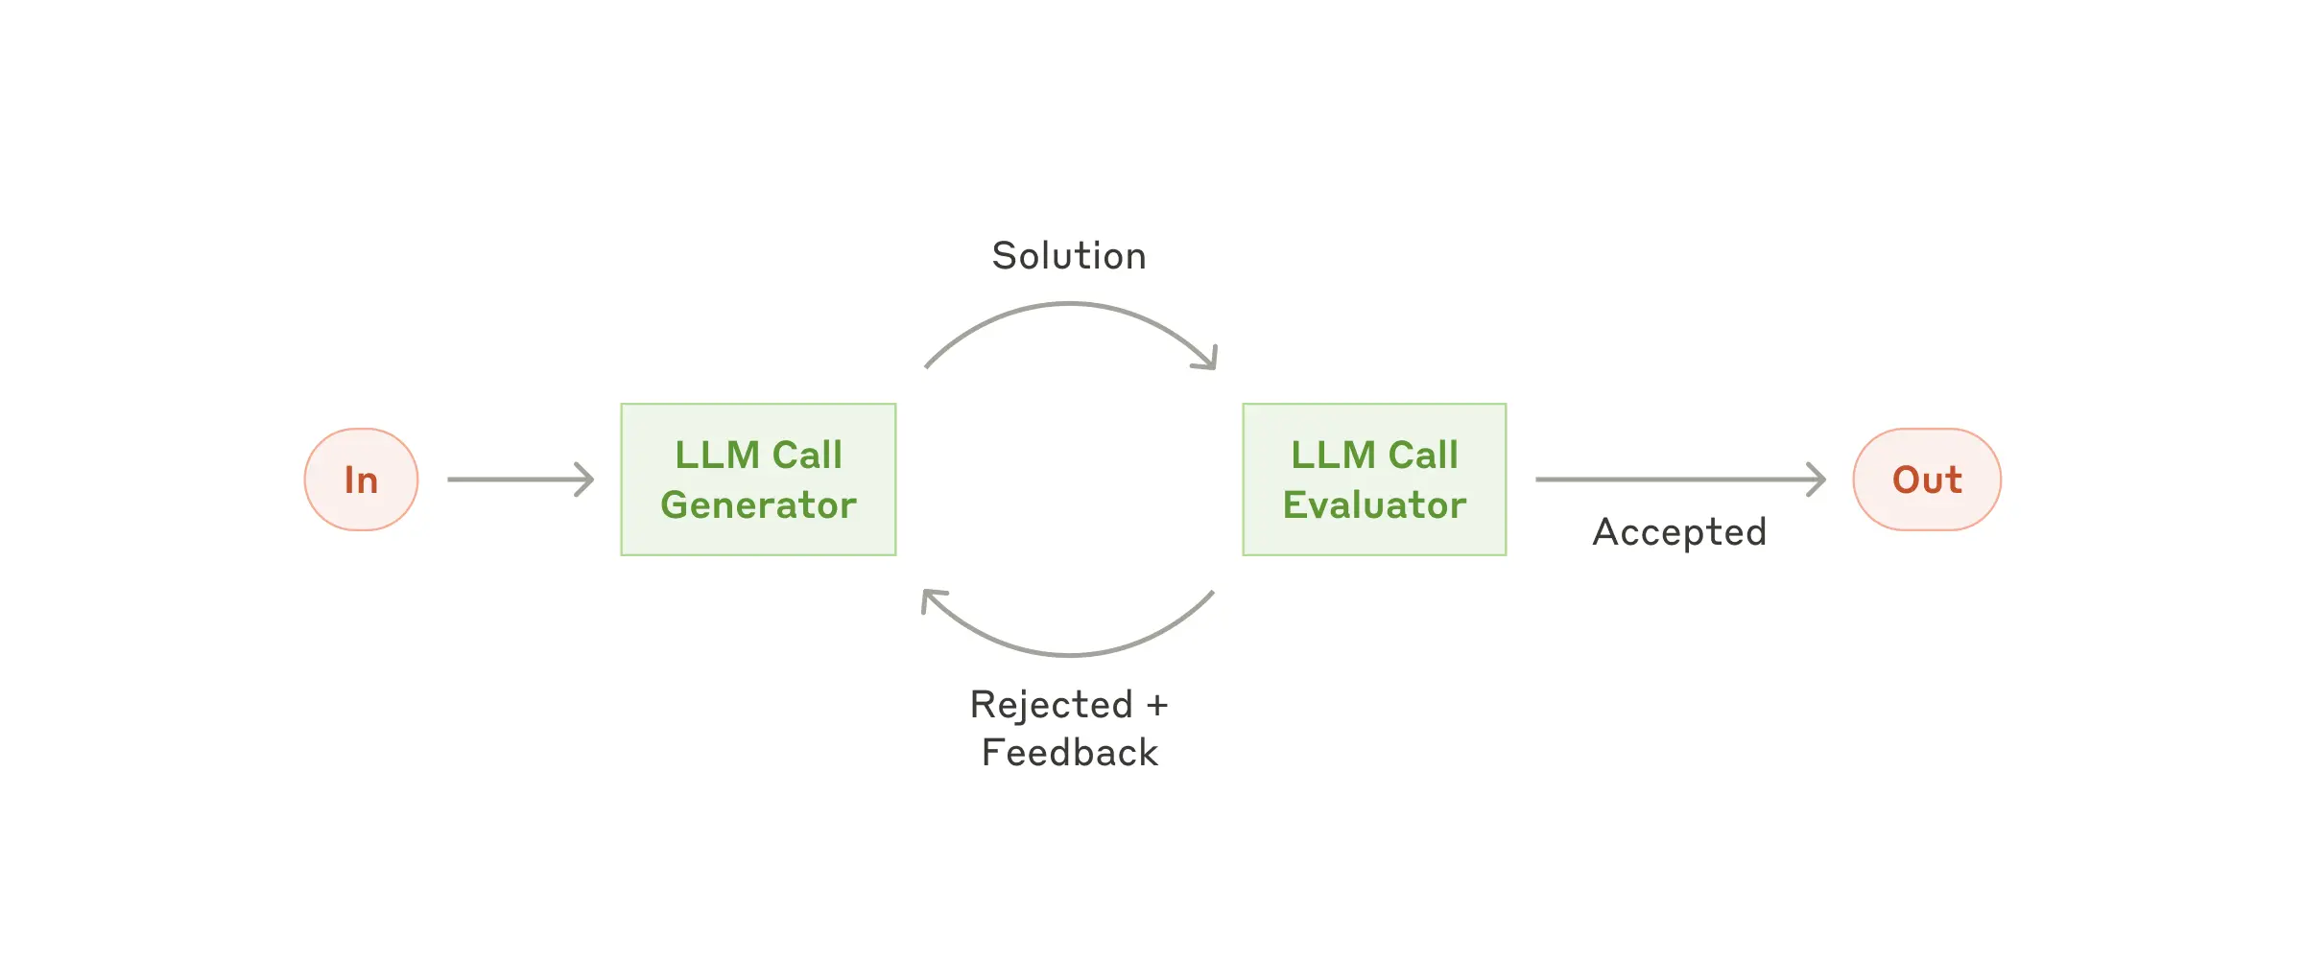
LLM Routing: Reasoning Agents_
01
Bsides ICS
_08

Slide 10
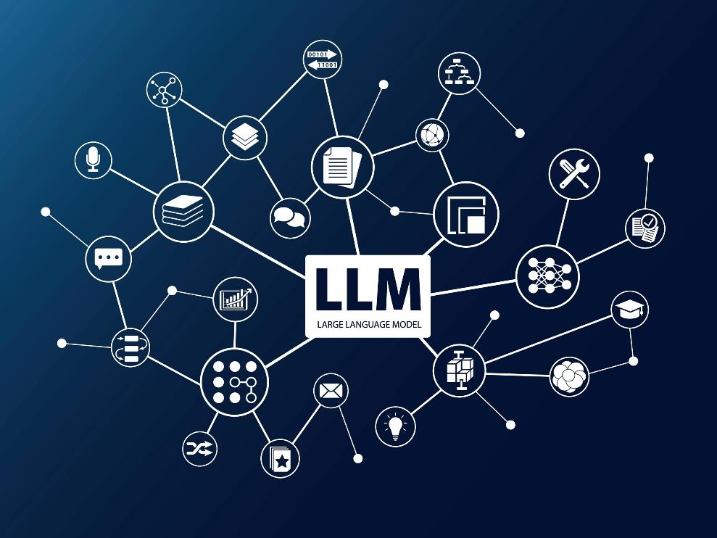
01
Create the Process
HOW TO DO IT
STEP-BY-STEP_
02
Define Requirements
Bsides ICS
03
Define Tools
04
Define Experience
NOTE: This presentation is predicated on the idea of ”using AI to create AI.”
05
Plug Into Cursor
_09

Slide 11
01
Create the Process
HOW TO DO IT
STEP-BY-STEP_
02
Define Requirements
Bsides ICS
03
Define Tools
04
Define Experience
05
Plug Into Cursor
_10

Slide 12
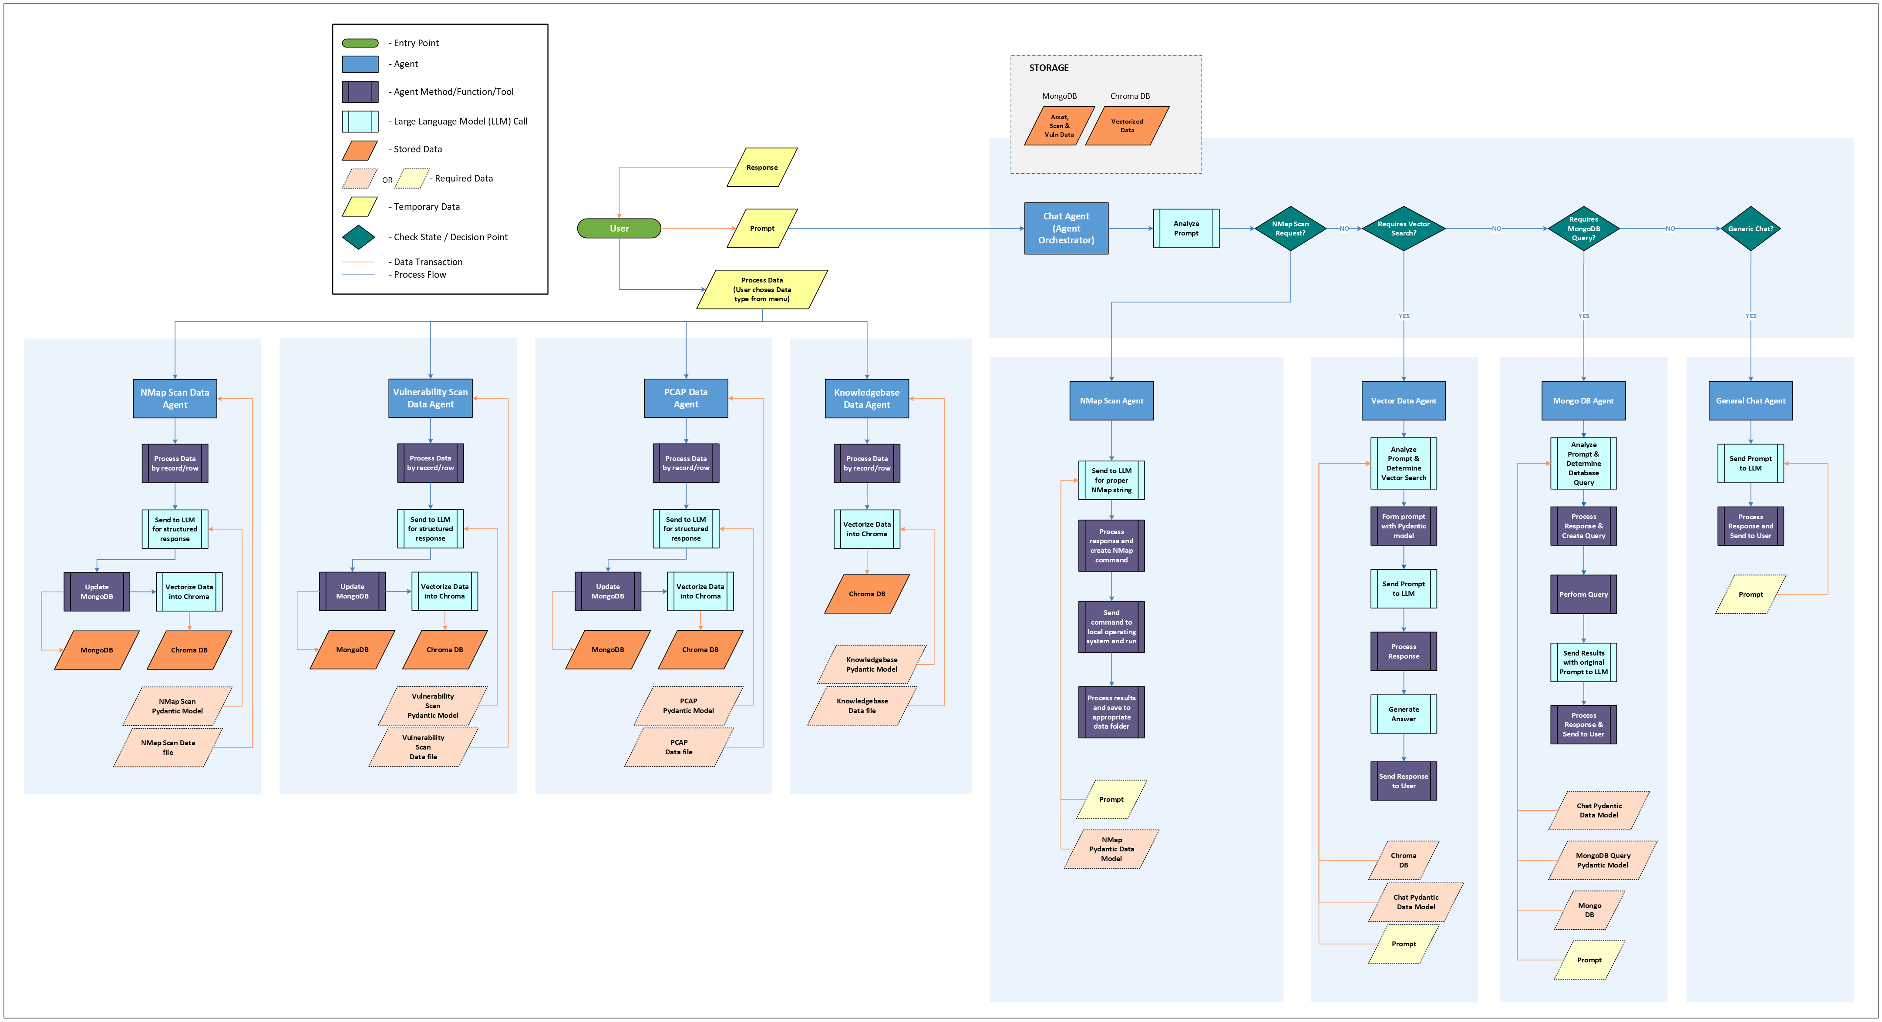
How to do it: Architecture Diagram_
01
Bsides ICS
_11

Slide 13
How to do it: Step-by-Step_
Create the Process
The LLM won’t build the process.
YOU build the process.
Start with a natural process flow. (flowchart)
Start with a basic process flow.
Flesh out details starting with data models.
Detail out process steps.
This is just a good practice, in general.
Pro Tip: Preprocess and do as much with code, first, before sending to the LLM.
01
Bsides ICS
_12
Notes:
Anyone that can think systematically can do this

Slide 14
How to do it: Architecture Diagram_
01
Bsides ICS
_11

Slide 15
01
Create the Process
HOW TO DO IT
STEP-BY-STEP_
02
Define Requirements
Bsides ICS
03
Define Tools
04
Define Experience
05
Plug Into Cursor
_13

Slide 16
How to do it: Step-by-Step_
Define the Requirements
Languages, databases, tools, conventions, etc.
Think of it like a README.md
Code samples (doesn’t have to be on-topic)
Documentation (docs and URLs)
Pydantic is the secret to stability (All other major AI frameworks use it.)
https://pydantic.dev/
Consider LangGraph or Pydantic AI for Agent Framework
https://www.langchain.com/langgraph
https://ai.pydantic.dev/
01
Bsides ICS
_14
Notes:
I called an audible due to recent developments in Pydantic’s beta framework, Pydantic AI, which I like better than Langchain.

Slide 17
01
Create the Process
HOW TO DO IT
STEP-BY-STEP_
02
Define Requirements
Bsides ICS
03
Define Tools
04
Define Experience
05
Plug Into Cursor
_15

Slide 18
How to do it: Step-by-Step_
Define the Tools
Think of tools in terms of the function of that process/step.
Does this step use Nmap?
Does it write a document?
Does it write code?
Does it answer questions?
You don’t need to code the tools here. (More on this later.)
01
Bsides ICS
_16

Slide 19
01
Create the Process
HOW TO DO IT
STEP-BY-STEP_
02
Define Requirements
Bsides ICS
03
Define Tools
04
Define Experience
05
Plug Into Cursor
_17

Slide 20
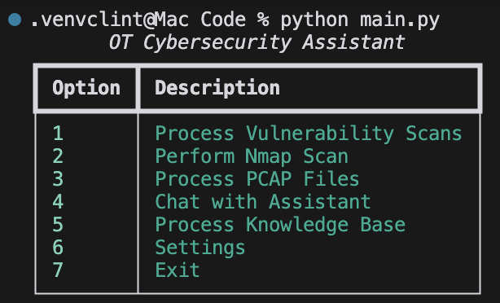
How to do it: Step-by-Step_
Define the User Experience
Is it a web UI?
Provide mockup Images.
Is it CLI?
Does it have a menu?
01
Bsides ICS
_18

Slide 21
01
Create the Process
HOW TO DO IT
STEP-BY-STEP_
02
Define Requirements
Bsides ICS
03
Define Tools
04
Define Experience
05
Plug Into Cursor
_19

Slide 22
How to do it: Step-by-Step_
Plug into cursor
https://www.trycursor.com/
All references and resources should be in the project directory structure.
Add reference documents to the composer.
Use the prompt I have provided.
Modify details as needed.
For Local LLM Only, You’ll Need Ollama:
https://ollama.com/
01
Bsides ICS
_20

Slide 23
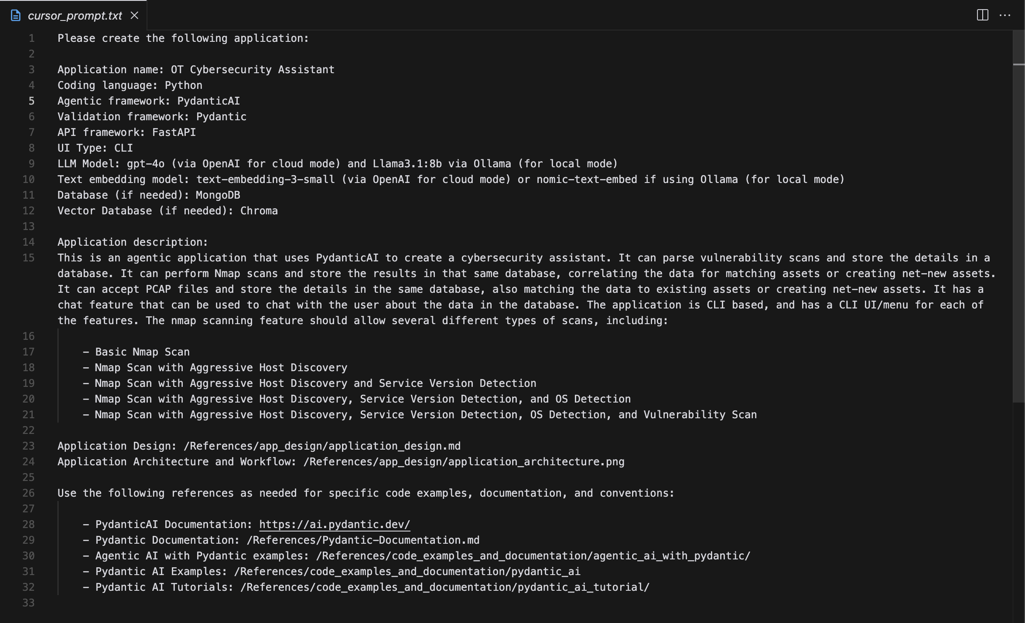
How to do it: Prompt_
01
Bsides ICS
_21

Slide 24
How to do it: Reference Docs_
01
Bsides ICS
_22

Slide 25
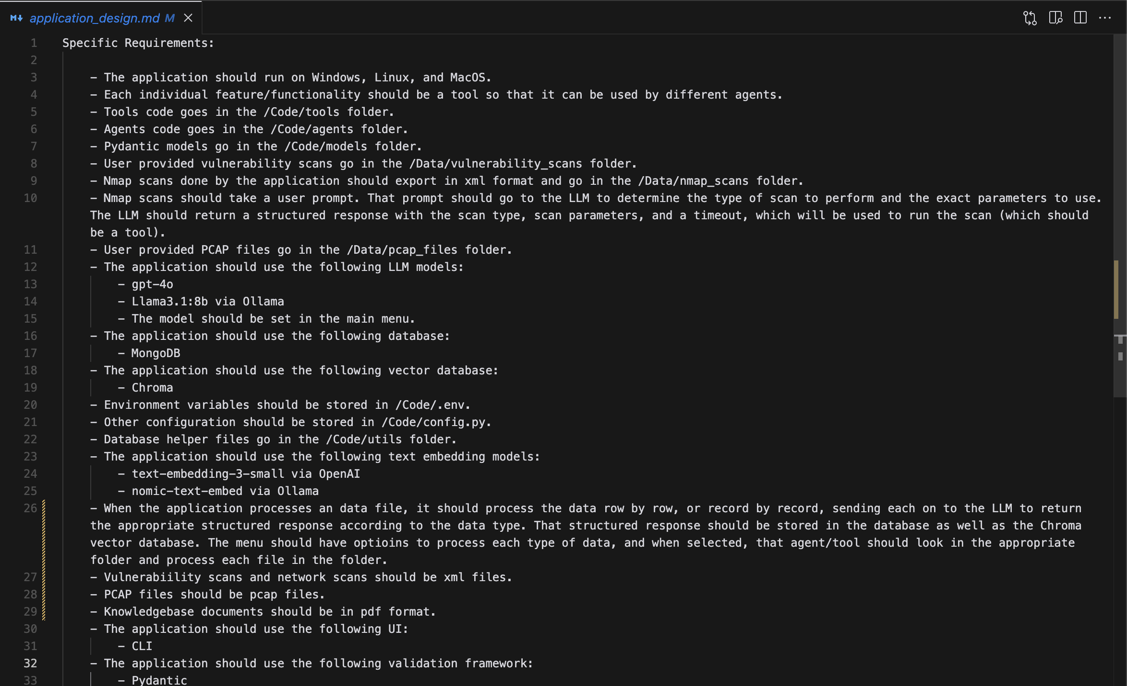
How to do it: Basic Design Document_
01
Bsides ICS
_23

Slide 26
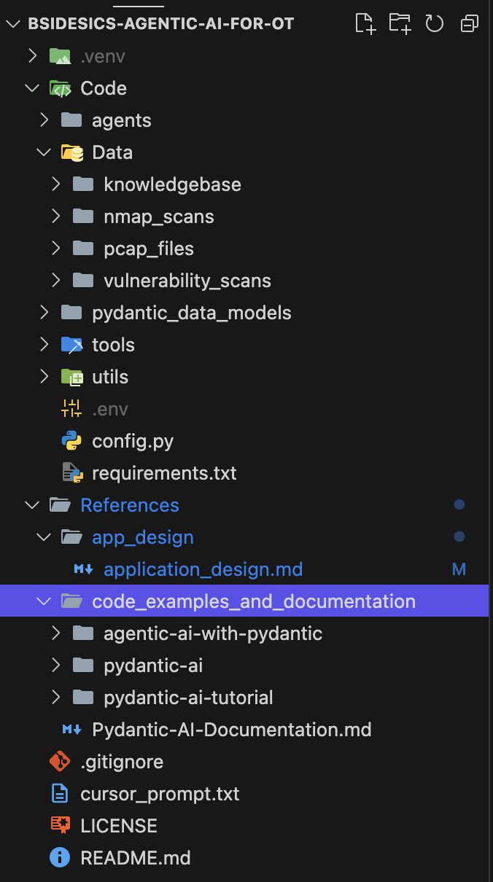
How to do it: Folder Structure_
Code
agents
Data
Knowledgebase
nmap_scans
Vulnerability_scans
data_models
tools
Utils
.env
config.py
References
01
Bsides ICS
_24

Slide 27
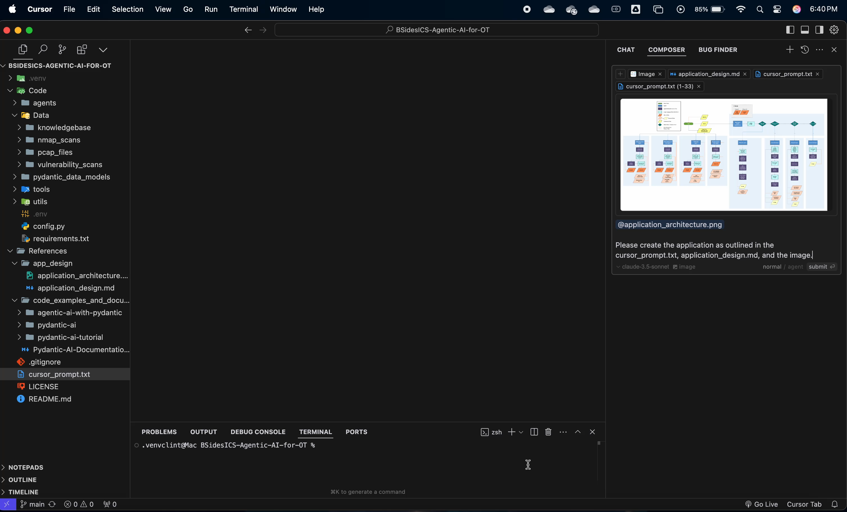
How to do it: Prompt Cursor_
01
Bsides ICS
_25

Slide 28
How to do it: Prompt Cursor_
01
Bsides ICS
_26

Slide 29
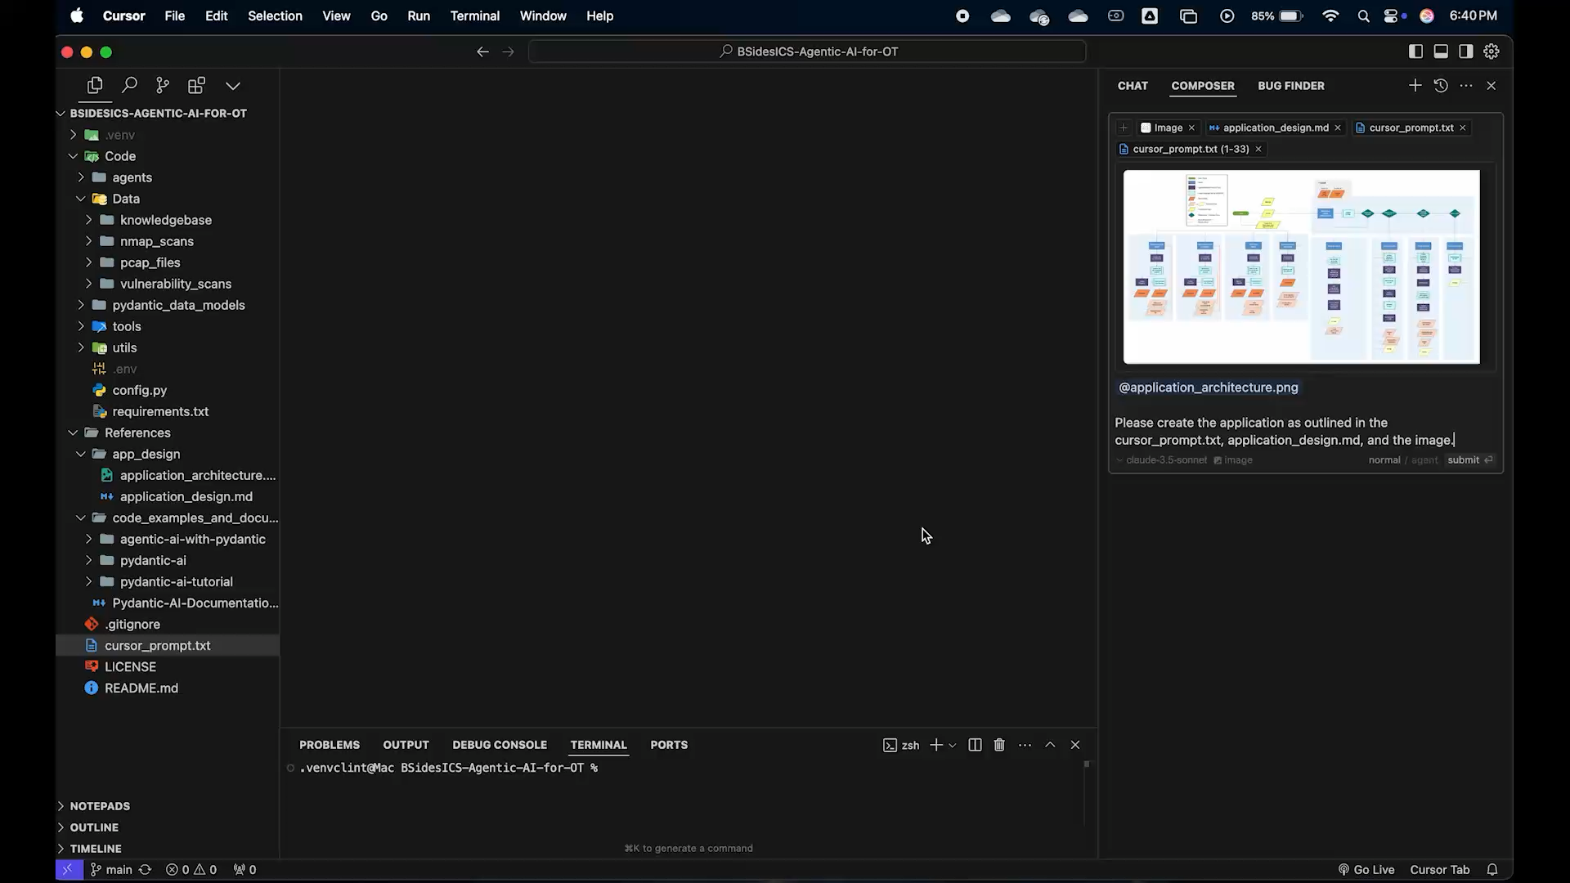
01
Bsides ICS
_20

Slide 30
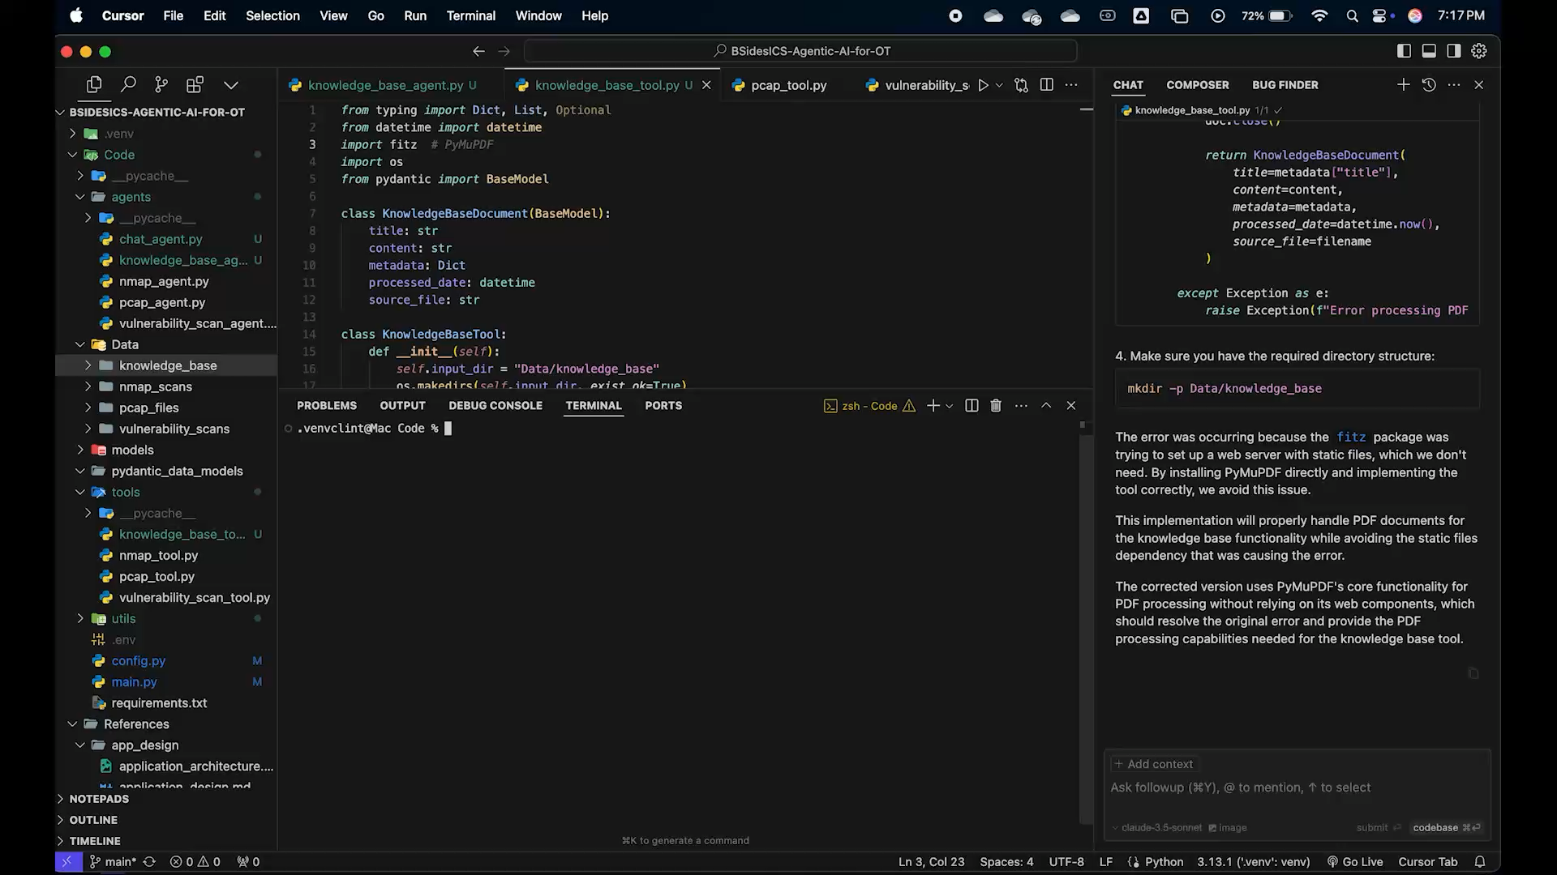
01
Bsides ICS
_20

Slide 31
Summary & Final Thoughts_
Follow and watch Dave Ebelaar on YouTube.
Provide Cursor a well thought out diagram.
Provide Cursor detailed requirements.
Pydantic is a MUST.
The LLM can’t do everything.
Preprocess as much as possible
Learn the basics.
Stay up to date.
Practice, practice, practice.
01
Bsides ICS
_29

Slide 32
Summary & Final Thoughts_
A few more people to follow:
https://www.youtube.com/@matthew_berman
https://www.youtube.com/@ColeMedin
https://www.youtube.com/@MervinPraison
https://www.youtube.com/@mreflow
https://www.youtube.com/@AllAboutAI
https://www.youtube.com/@NetworkChuck
https://www.youtube.com/@aiadvantage
https://www.youtube.com/@technovangelist
https://www.youtube.com/@AZisk
https://www.youtube.com/@CyberSuperhuman
01
Bsides ICS
_30

Slide 33


Thank You_
Get In Touch_
Bsides ICS
clint.bodungen@morganfranklin.com
MorganFranklin.com
ThreatGEN.com
_31

